Slide 1
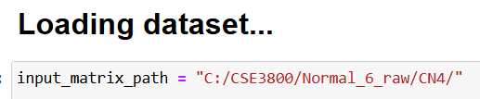

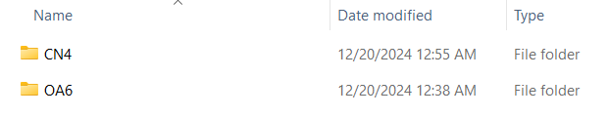
Create a folder to store data
Run DB_data_creation.ipynb to generate the data
Input matrix path can be changed to generate data for different samples
Make sure to change the destination directory to the correct folder
Each time the notebook is run, move all generated csv files into a new subfolder for the sample that was clustered

Slide 2
Setting up a virtual environment
https://www.geeksforgeeks.org/create-virtual-environment-using-venv-python/
If a permission error occurs when trying to activate the virtual environment run the following command in Powershell (command temporarily gives permission)
This keeps any libraries installed limited to this particular virtual environment

Slide 3

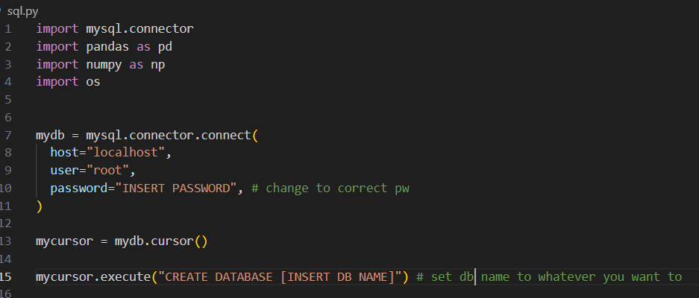
Create Database
May need to install mysql connector
A database has to be created before sql.py is run. The code can be altered to do this with in the same file by commenting and uncommenting certain lines.
This should be all the code that is needed for this part
Set the correct information to connect to MySQL
Also set DB name

Slide 4
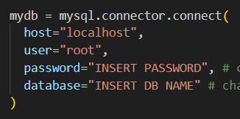
Creating Tables
Don't try to create another database when generating tables (recomment out line)
When connecting to MySQL this time, make sure to specify the DB
Change directory to where data is stored
Uncomment this line to create the sample table. This stores the names of the different samples (ex. OA6, CN4, etc)

Slide 5

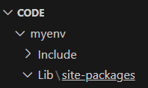
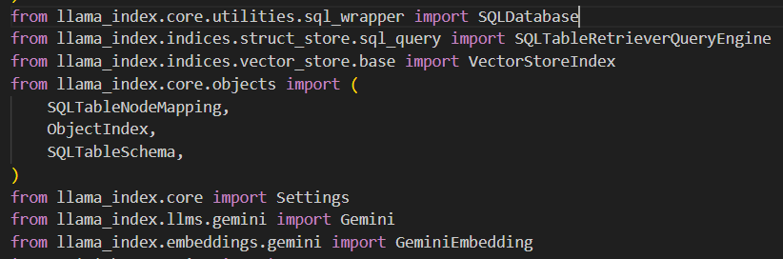
Make sure to pip install SQLAlchemy if not already installed
Setting up environment https://docs.llamaindex.ai/en/stable/getting_started/installation/
My install was missing some stuff from llama_index/core so I manually copy and pasted the correct files from the GitHub: https://github.com/run-llama/llama_index/tree/main/llama-index-core/llama_index/core
Navigate to Lib/sitepackages in your virtual env folder to see what files were installed
The file locations for the modules in sitepackages can be seen from the import statements

Slide 6
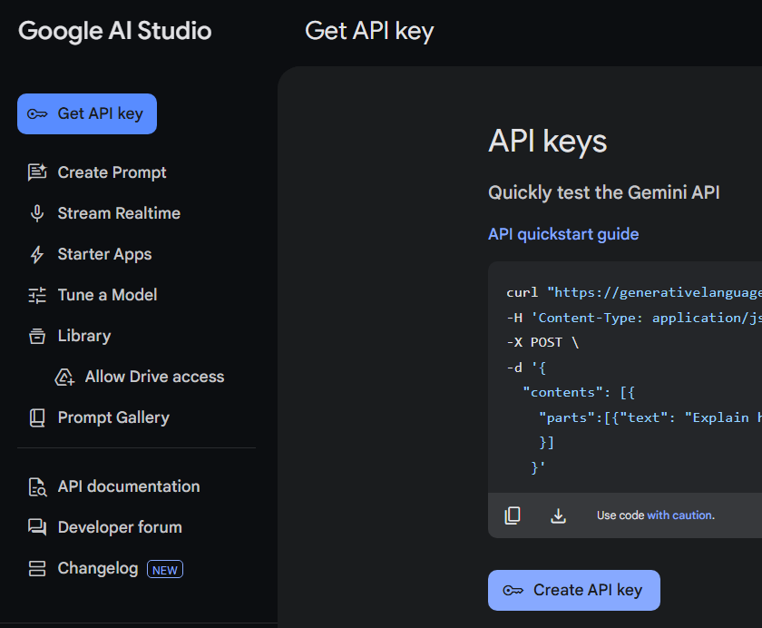
Using Gemini https://docs.llamaindex.ai/en/stable/examples/llm/gemini/
Navigate to Google AI Studio -> Get API Key -> Create API Key
Copy and paste key into proper place in nlp.py
Can change specific model here
Try different queries
Run program to see results

